Slide 1
Black Friday Sale Prediction
Done by Padmavathi

Slide 2


Slide 3
BLACK FRIDAY PREDICTION
Problem Statement
A retail company “ABC Private Limited” wants to understand the customer purchase
behaviour (specifically, purchase amount) against various products of different
categories. They have shared purchase summary of various customers for selected high
volume products from last month. The data set also contains customer demographics
(age, gender, marital status, city_type, stay_in_current_city), product details
(product_id and product category) and Total purchase_amount from last month.
Now, they want to build a model to predict the purchase amount of customer against
various products which will help them to create personalized offer for customers against
different products.

Slide 4
Data attributes used
• Variable Definition
• User_ID User ID
• Product_ID Product ID
• Gender Sex of User
• Age Age in bins
• Occupation Occupation (Masked)
• City_Category Category of the City (A,B,C)
• Stay_In_Current_City_Years Number of years stay in current city
• Marital_Status Marital Status
• Product_Category_1 Product Category (Masked)
• Product_Category_2 Product may belongs to other category also (Masked)
• Product_Category_3 Product may belongs to other category also (Masked)
• Purchase Purchase Amount (Target Variable)

Slide 5
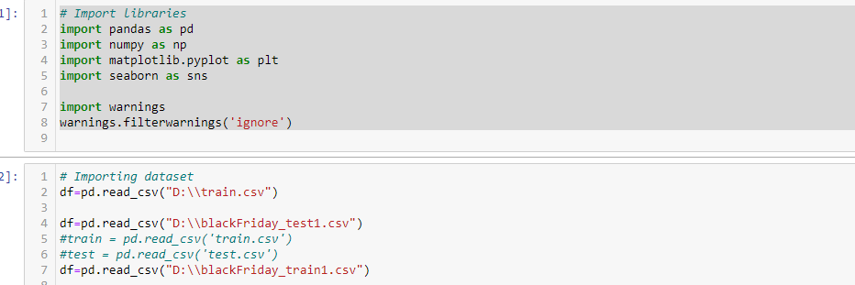
Importing the necessary libraries

Slide 6
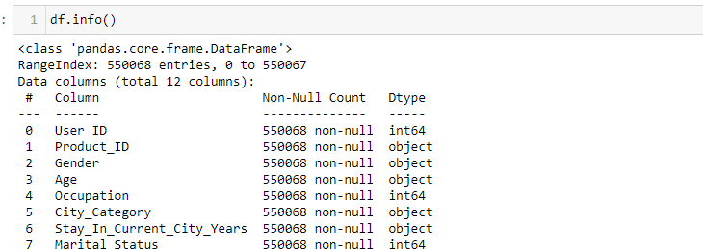
Data types used

Slide 7
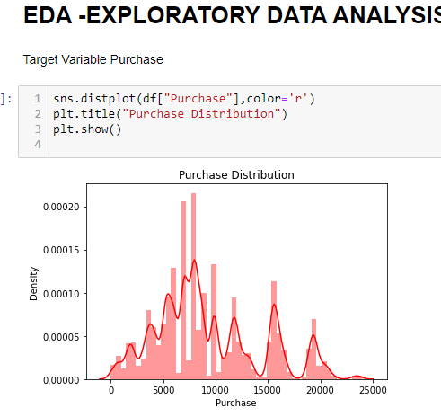
EDA- anlaysis
We can observe that purchase amount is repeating for many customers.This may be because on Black Friday many are buying discounted products in large numbers and kind of follows a Gaussian Distribution.

Slide 8
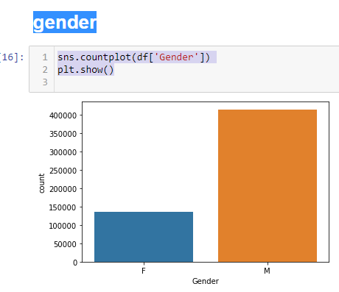
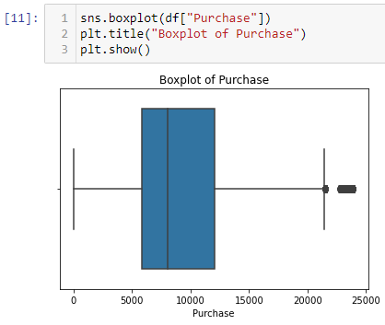
Analysis of Purchase and Gender count

Slide 9
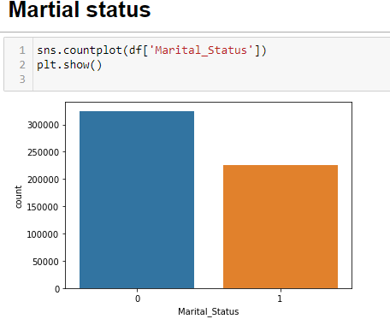
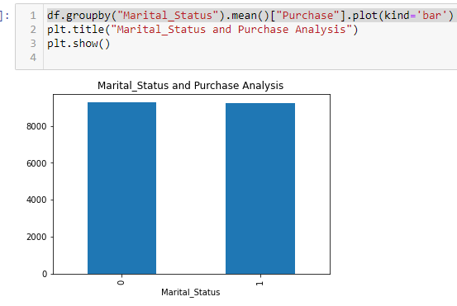
Analysi with martial status with purchase

Slide 10
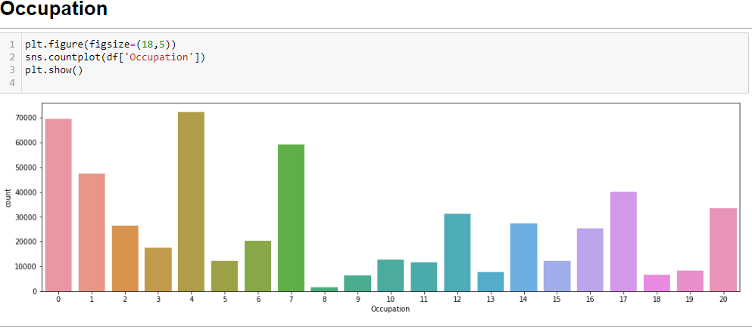
Analyse with occupation
observation in Occupation : it has at least 20 different values. Since we do not known to each occupation each number corresponds, is difficult to make any analysis. Furthermore, it seems we have no alternative but to use since there is no way to reduce this number

Slide 11
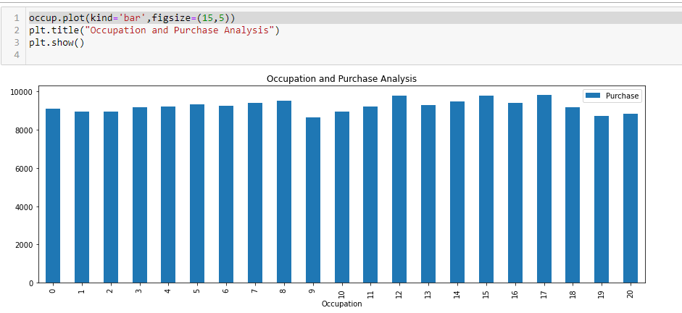
Compare with Occupation and Purchase
observation:
- Although there are some occupations which have higher representations, it seems that the amount each user spends on average is more or less the same for all occupations.

Slide 12
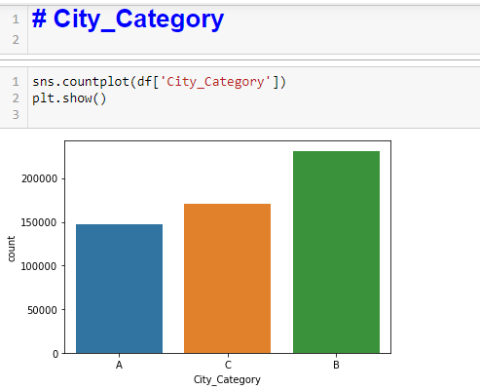
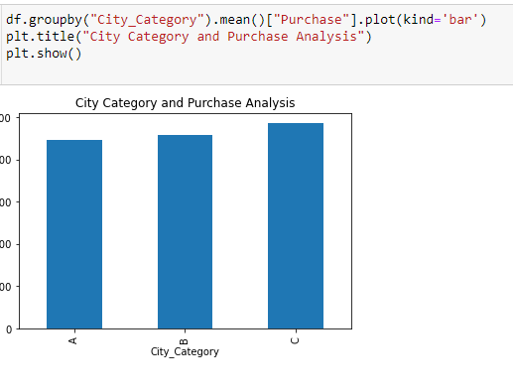
Analysis with city and purchase

Slide 13
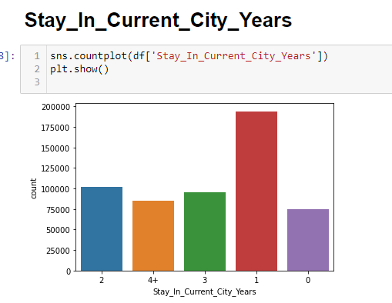
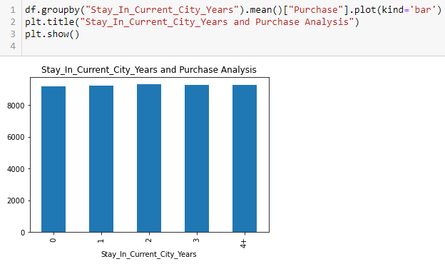
Analysis with city and purchase

Slide 14
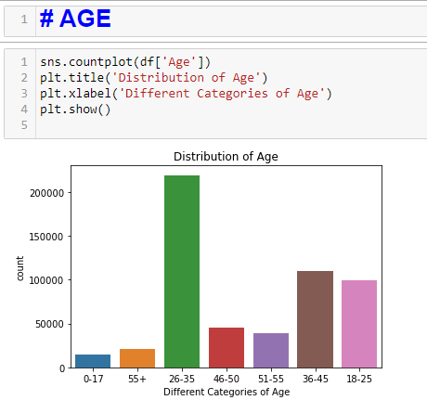
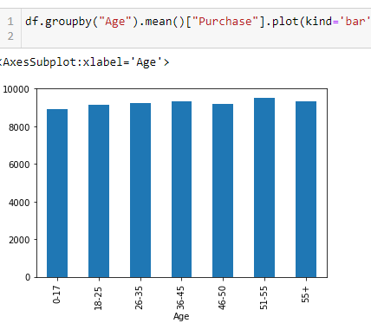
Analsing with age

Slide 15
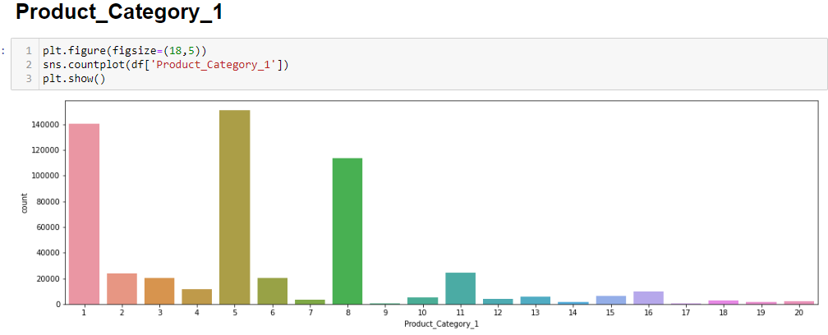
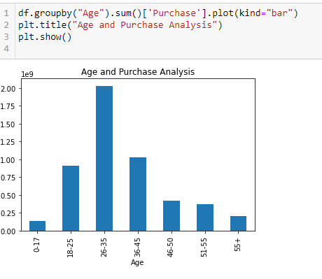
Analyse age and product analysis

Slide 16
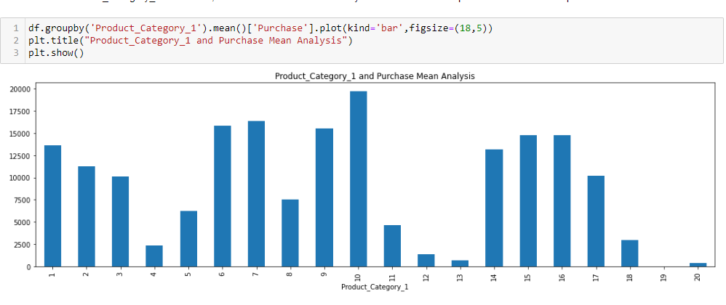
Comparing Product category 1 and 2

Slide 17
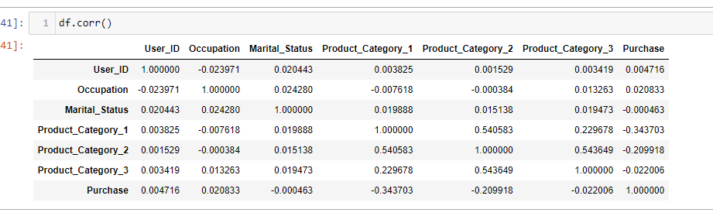
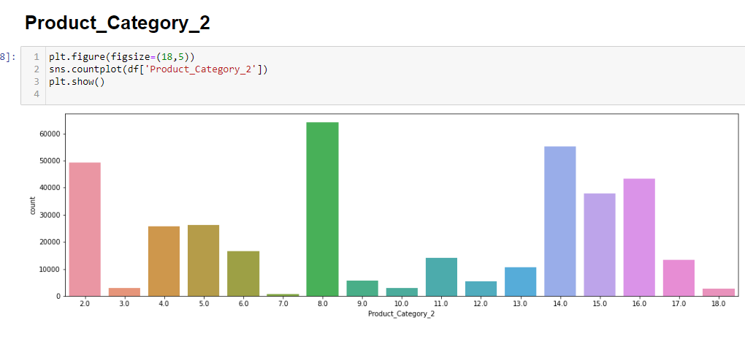
Product Category 2

Slide 18
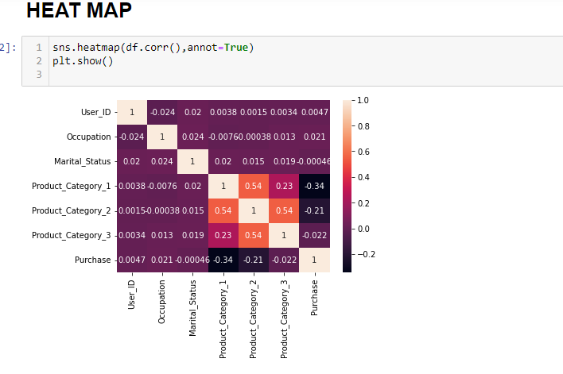

Slide 19
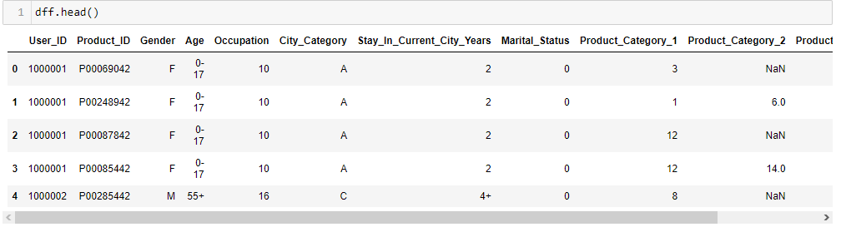

Slide 20
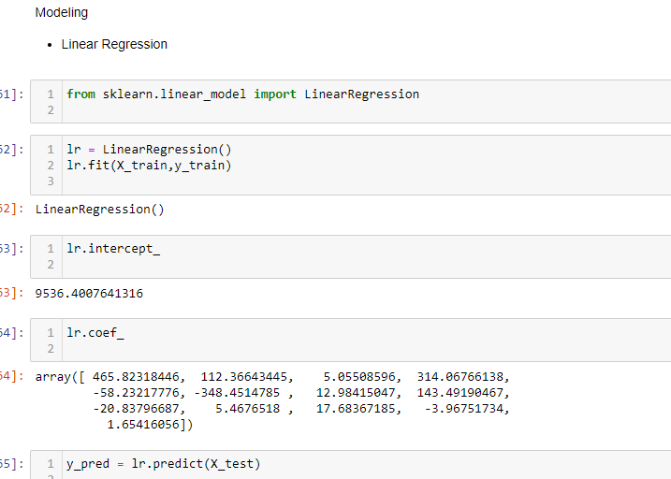

Slide 21
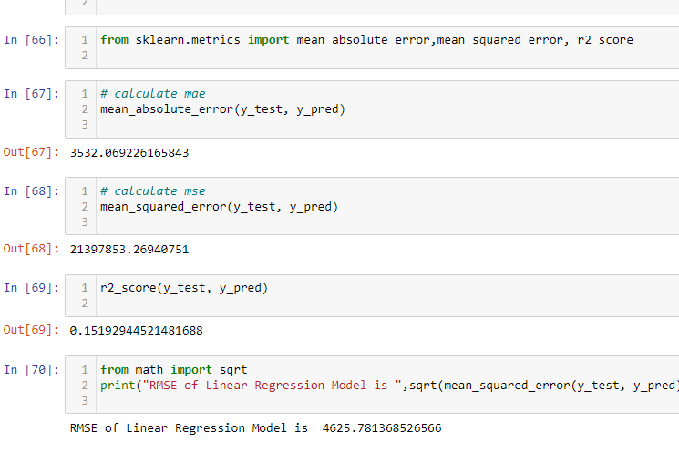

Slide 22
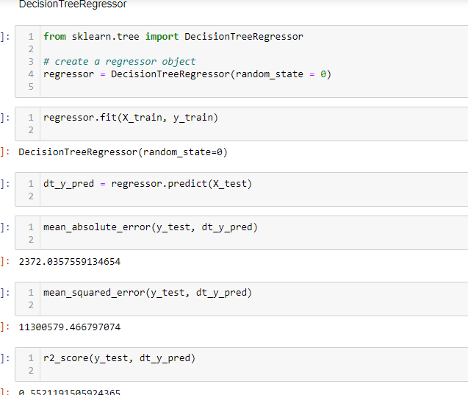

Slide 23
Decision tree Regressor

Slide 24
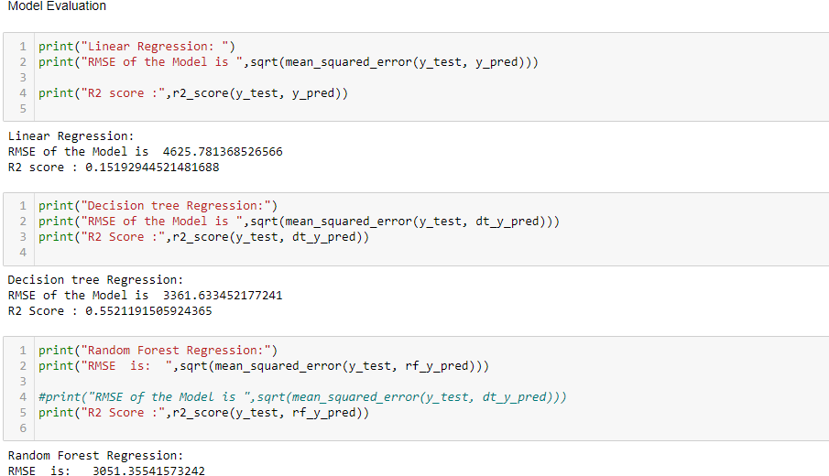
Model evaluation

Slide 25
conclusion
From the three model I tried Random Forest Regression is best . still we can try on KNN,and XGB to decide best EDA. completed as per project assigned.

Slide 26
THANK YOU!

